Slide 1
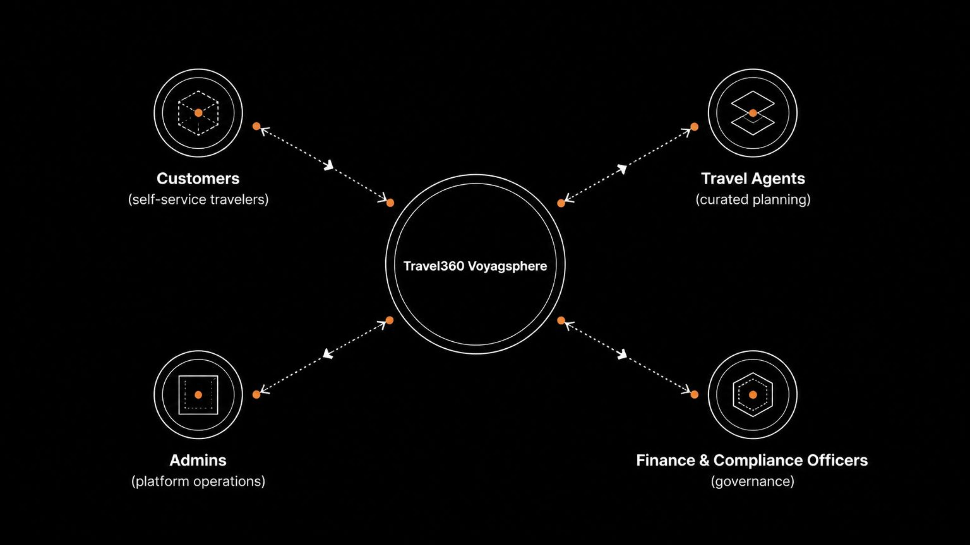
Travel360 (Voyagsphere)
An Enterprise-Grade Travel Management Ecosystem
Presenter
Project Type
Pisini Joel
Full-Stack Development Final Year Project
Platform
Stack
B2B2C Travel Management
Angular · Spring Boot · MySQL
A unified ecosystem bridging travelers, agents, and enterprise operations in a single platform.

Slide 2
PROJECT OVERVIEW
Problem, Solution & Objectives
The Problem
Booking Lifecycle
Travel planning suffers from fragmented communication between customers, travel agents, and service providers — leading to booking errors, delays, and poor customer experience. No single system manages the end-to-end travel lifecycle across all stakeholders simultaneously.
Search
Real-time availability query across flights, hotels, and transport
The Solution
Travel360 is a centralized B2B2C travel platform managing the complete travel lifecycle — from search to payment — in a single unified ecosystem. It bridges the gap between self-service convenience and agent-driven personalization.
Request
Booking request submitted — self-service or via agent
Key Objectives
End-to-end booking management — search, book, invoice, pay in one flow
Unified customer experience — self-service and agent-assisted channels
Automated workflows — invoicing, notifications, audit logging
Enterprise-grade architecture — layered, secure, scalable
Booking
Validation, confirmation, and system lock of reservation
Payment
Encrypted, JWT-authenticated payment processing
Compliance
Audit log captured, invoice issued, record immutably stored

Slide 3
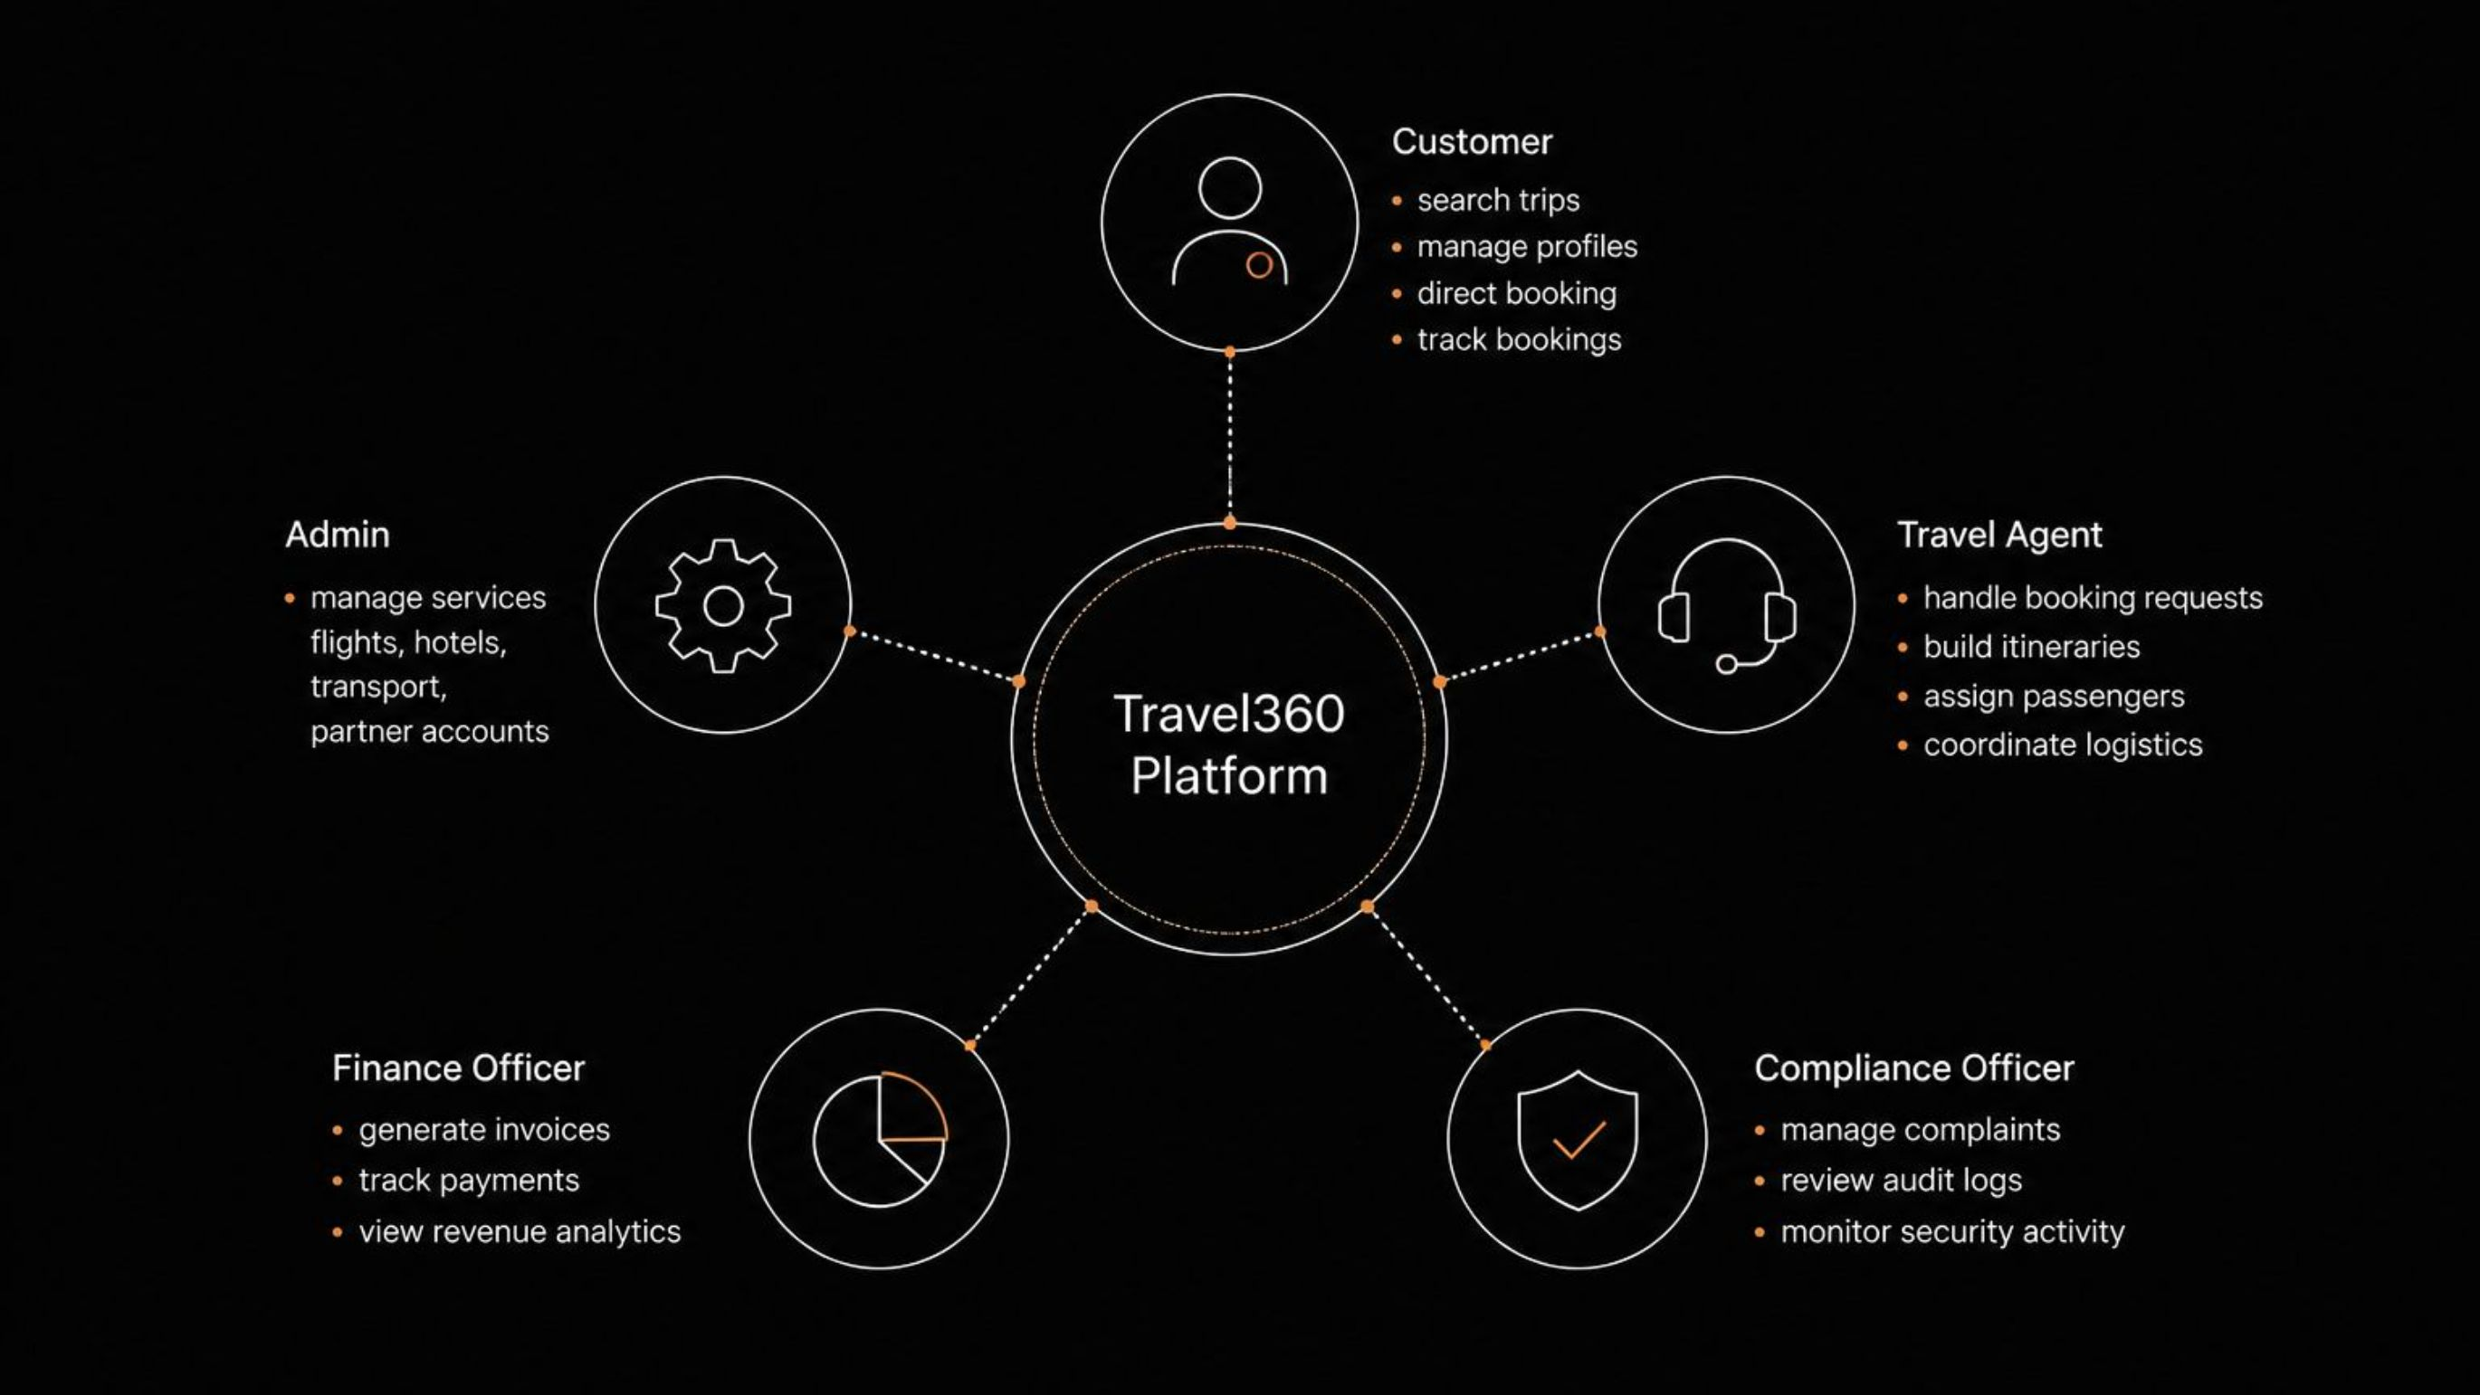
USER ECOSYSTEM
Role-Based Access Control (RBAC)
Travel360 implements a 5-role RBAC model, each with scoped permissions and dedicated UI views, all centered around the Travel360 platform core. Every role interacts exclusively through its authorized interface layer, ensuring data isolation and operational clarity.
Customer
Travel Agent
Admin
Search, book, track — full self-service access
Itinerary building, passenger assignment, logistics
Service management: flights, hotels, transport
Finance Officer
Compliance Officer
Invoicing, payment tracking, revenue analytics
Complaints, audit logs, security monitoring

Slide 4
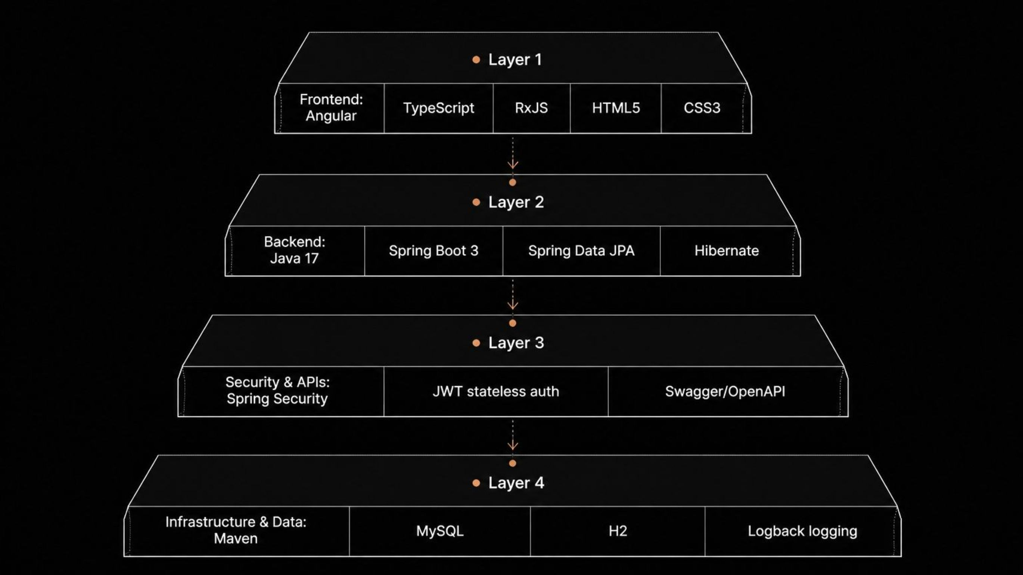
TECHNICAL STACK
Layered Architecture & Technology Stack
Frontend
Backend
Angular · TypeScript · RxJS · HTML5 · CSS3 — Reactive single-page application with declarative UI components and observable data streams
Java 17 · Spring Boot 3 · Spring Data JPA · Hibernate — Enterprise-grade RESTful API layer with ORM-managed persistence
Security & APIs
Infrastructure & Data
Spring Security · JWT (stateless auth) · Swagger / OpenAPI — Zero-trust authentication model with auto-generated API documentation
Maven · MySQL / H2 · Logback logging — Build automation, dual-database support (prod/test), structured application logging

Slide 5








BOOKING ARCHITECTURE
Dual-Channel Booking Architecture
Travel360 supports two parallel booking channels, catering to different traveler profiles and complexity levels. Each channel is independently optimized while sharing a common service backbone.
CHANNEL A
CHANNEL B
Self-Service Booking
Agent-Assisted Booking
Target: Fast, independent (DIY) travelers seeking immediate confirmation
Target: Luxury & customized travel experiences requiring expert curation
Customer Initiates Search
Customer Submits Request
Direct Booking Selection
Agent Reviews & Builds Itinerary
Automatic Invoice Generation
Passenger Assignment & Logistics
Secure Payment
Customer Approval → Payment

Slide 6

SELF-SERVICE CHANNEL
Self-Service Flow: Direct Booking Workflow
The self-service channel leverages Spring Boot microcomponents to deliver a seamless, real-time booking experience with zero agent intervention. Each step maps directly to a named service component in the backend architecture.
Key Capabilities
Customer
BookingController
Payment Gateway
Angular UI initiates request
Validate and process booking
Encrypted payment processing
Real-Time Search
Instant Booking
Live availability across flights, hotels, and transport simultaneously queried via SearchService
No manual approval required — BookingController validates and confirms in a single transaction
SearchService
InvoiceService
Real-time availability query
Auto-generate itemized invoice
Each node represents a distinct Spring Boot component. The flow is fully automated — no manual step is required between search and confirmation.
Auto Invoice Generation
Secure Payment
JWT-authenticated, encrypted transaction processed through the Payment Gateway component
InvoiceService triggered on booking confirmation — itemized by service type, tax, and total

Slide 7
AGENT-ASSISTED CHANNEL
Agent-Assisted Flow: Curated Travel Planning
The agent-assisted channel enables personalized, multi-passenger travel planning with full agent oversight and customer approval gates — ensuring quality control before payment is collected.
Distinguishing Features
Request
Review
Passenger
Customer submits travel preferences
Agent reviews and contacts suppliers
Assign seats, rooms, transport
Personalized Planning
Multi-Passenger Management
Agent tailors every detail — destinations, accommodation class, transport preferences — to individual customer needs
Group bookings with individual seat, room, and transport assignments per traveler via PassengerService
Assign
Itinerary
Log request and assign to agent
Service builds multi‑leg itinerary
Step 6 (Customer Approval) acts as a mandatory decision gate — the booking cannot proceed to confirmation without explicit customer sign-off.
Customized Itineraries
Approval Gate
Mandatory customer sign-off before booking is locked — prevents unauthorized charges and ensures satisfaction
Multi-destination, multi-service packages structured via ItineraryService with full leg-by-leg detail

Slide 8
PLATFORM OPERATIONS
Finance & Compliance Modules
FINANCE MODULE
COMPLIANCE MODULE
Revenue & Payment Operations
Governance & Security Operations
Automated Invoices
Complaint Management
Generated on booking confirmation, itemized by service type, taxes, and totals — zero manual input
Structured intake, assignment to Compliance Officer, and resolution tracking with status lifecycle
Payment Tracking
Audit Logging
Real-time status flags: Pending, Paid, Overdue — visible to Finance Officers dashboard
AOP-powered @Audit annotation captures all critical actions automatically — non-invasive cross-cutting concern
Revenue Dashboard
Security Monitoring
Booking volume, revenue trends, and agent performance analytics in a single operational view
JWT token activity, failed authentication attempts, and role violation events tracked in real time
Booking Analytics
Activity History
Service-level breakdown, peak period reporting, and conversion funnel visibility
Full immutable log per user, booking, and transaction — tamper-proof audit trail for regulatory compliance

Slide 9
ENGINEERING EXCELLENCE
Design Patterns & Best Practices
Travel360 is engineered to enterprise standards, applying six foundational software engineering patterns that ensure security, maintainability, and scalability at every layer.
Aspect-Oriented Programming
JWT Authentication
@Audit annotation intercepts service calls for automatic, non-invasive audit logging without polluting business logic
Stateless, token-based security — no server-side session storage; horizontally scalable across distributed deployments
DTO Pattern
Global Exception Handling
Strict entity/API separation via Data Transfer Objects — prevents internal model exposure and enforces API contracts
@ControllerAdvice centralizes error responses — consistent HTTP status codes and payloads across all endpoints
Clean REST Architecture
Layered Architecture
Resource-oriented endpoints, versioned APIs, fully documented via Swagger/OpenAPI auto-generation
Strict separation: Controller → Service → Repository — each layer independently testable and replaceable

Slide 10
ENGINEERING CHALLENGES
Challenges & Solutions
Five significant technical challenges were encountered and resolved during development, each informing a deliberate architectural decision that strengthened the overall system design.
#
Challenge
Solution
1
Complex entity relationships — Booking ↔ Itinerary ↔ Passenger ↔ Invoice interdependencies causing mapping complexity
Normalized relational database schema + MapStruct object mapping for clean, type-safe DTO conversion
2
Role-based authorization across 5 distinct user types with different access scopes and UI states
Spring Security with @PreAuthorize annotations + Angular Route Guards for dual-layer frontend enforcement
3
Dual booking channel logic — two distinct flows without code duplication or maintenance burden
Shared service layer with channel-specific controllers; Strategy Pattern for booking flow selection at runtime
4
Audit trail requirement without polluting business logic across dozens of service methods
AOP-based @Audit interceptor — cross-cutting concern handled transparently, zero business logic modification
5
API security and documentation — maintaining secure, well-documented endpoints across all roles
JWT stateless authentication + Swagger/OpenAPI auto-generated docs, always in sync with controller definitions

Slide 11
FUTURE ROADMAP
Travel360 Evolution Roadmap
Phase 1
Phase 3
Phase 5
Real-Time Updates
WebSockets integration for live booking status, agent notifications, and payment confirmations
Microservices Migration
Decompose monolith into independently deployable services: Booking, Payment, Notification, Compliance
Third-Party Integrations
Live Airline APIs, Hotel APIs (Amadeus, Booking.com), Payment Gateways (Stripe, PayPal)
1
2
3
4
5
Phase 2
Phase 4
AI Recommendations
ML-powered travel suggestions based on user history, preferences, and seasonal trends
Cloud Deployment
Containerization with Docker + orchestration via Kubernetes; full CI/CD pipeline integration
What Was Built
Thank You
5-Role RBAC
Dual Channels
Presented by Pisini Joel
Scoped access across all user types
Self-service + agent-assisted flows
Finance & Compliance
Enterprise Patterns
Automated invoicing + audit trail
AOP, JWT, DTO, REST, Layered Architecture

